Slide 1

MEDIA & THE PUBLIC
Week 8 Spiral of silence
Ryan Wang
ryanyang@psu.edu

Slide 2
Strong/Powerful media effect
McQuail’s four phrases model (2005)
WWI - 1930s
1930s – 1960s
Selective exposure
Magic Bullet
Hypodermic Needle
1960s – 1970s
Two-step flow
1970s -
Spiral of silence
Cultivation
Social constructivism
Framing
Agenda setting
Limited media effect
Revisit of strong media effect
Negotiated/transactional media effect

Slide 3
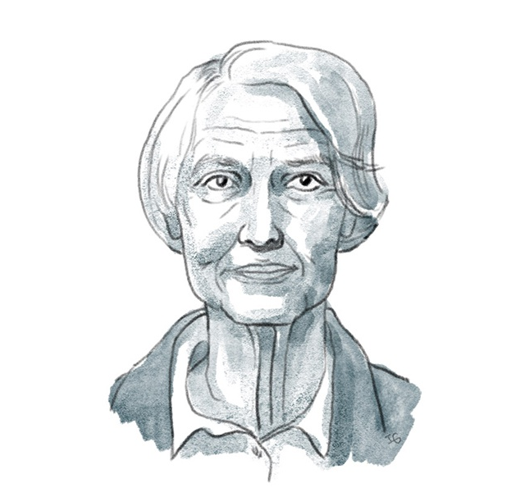
Spiral of Silence Theory
Elisabeth Noelle-Neuman
What is the spiral of silence?
The spiral of silence theory posits that people would be more likely to stay silent about their beliefs if they hold a minority opinion. If minority voices continue to stay silent, the minority opinions will end up extinguishing in public debate, which is known as the process of the spiral of silence (Noelle-Neumann, 2008)

Slide 4
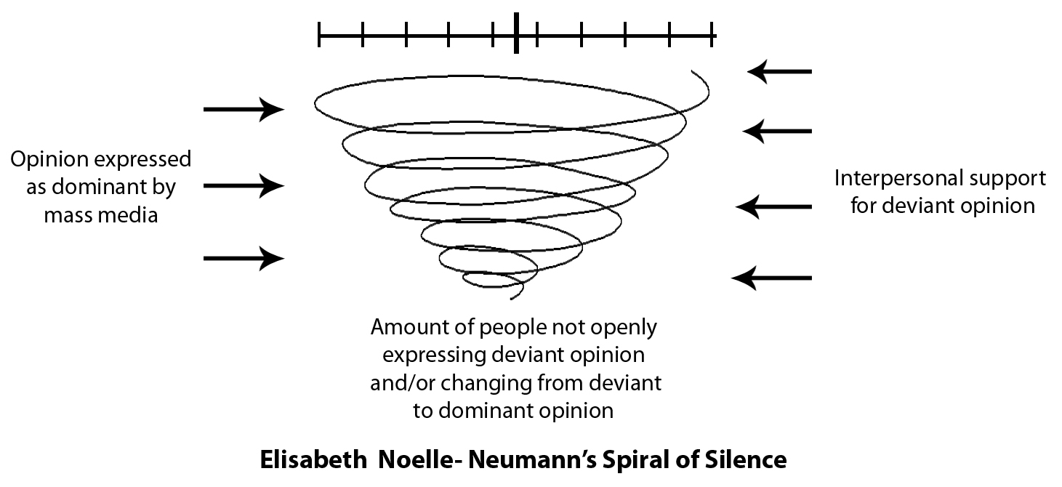
Spiral of Silence Theory
Origins
1965 German federal election campaign
The governing Christian Democratic Union–Christian Social Union (CDU-CSU) and the opposing Social Democratic Party of Germany (SDP), were in a dead heat (45%)
A last-minute swing in favor of the CDU-CSU (45% - 50%), and SDP support rate dropped to less than 40 percent.
CDU-CSU won with 48 percent of the vote, as against 39 percent for the SDP.
Noelle-Neumann: Queen Elizabeth II’s visit to Germany in May 1965, during which she was often accompanied by the Christian Democratic German chancellor, Ludwig Erhard.

Slide 5
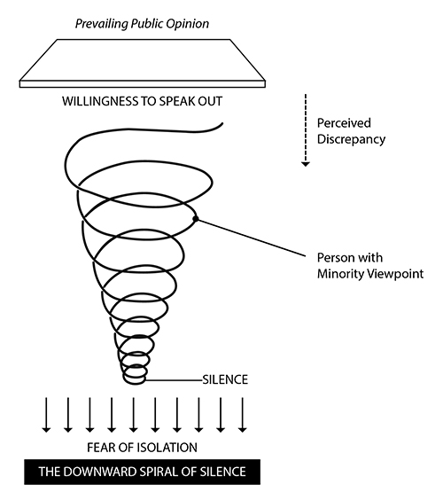
Key elements of Spiral of Silence
We as human being are afraid of Fear of isolation as being isolated from society and also of being ostracized or criticized for failing to go along with the majority relative to specific issues under debate
People tend to monitor the environment and observe other people’s behavior to see whether their own views fit into Opinion climate (especially on controversial topics)
To avoid isolation, people tend to refrain from publicly stating their views on controversial matters when they perceive that doing so would attract criticism, scorn, laughter, or other signs of disapproval.
Meanwhile, those who sense that their opinions will meet with approval tend to voice them fearlessly and at times vociferously
A spiraling process begins, the dominant camp becoming ever louder and more self-confident while the other camp becomes increasingly silent.
Notes:
Importantly, the spiral of silence occurs only in connection with controversial issues that have a strong moral component. What triggers a person’s fear of isolation is the belief that others will consider him or her not merely mistaken but morally bad. Accordingly, issues that lack a moral component or on which there is general consensus leave no room for a spiral of silence.

Slide 6
Reference

